Slide 1

Presentation and Design Choices
Developed by:
Alessandro Pasquetto
Lorenzo Orlandi
Gabriele Pedesini
Stefano Molteni

Slide 2
Implemented Functionalities
Rules
✅ Basic rules
✅ Complete rules
Connection
✅ Socket
✅ RMI
User Interface
✅ TUI
✅ GUI
Additional Functionalities
✅ Demo travel
✅ Multiple games
✅ Resilience
❌ Persistence

Slide 3
MVc Pattern
Server | Client
Model Contains most of the game logic and is responsible for maintaining the state and information related to the various ongoing matches. Controller Handles the orchestration of the different game phases, and manages the requests and responses of the various users. | View Whether it's a TUI or a GUI, it contains the logic for creating the user interface and managing all possible user interactions. Model A more lightweight model whose purpose is to maintain a consistent local state on the client side, in order to minimize the amount of data exchanged with the server.
On both the server and client sides, dedicated classes are implemented to manage communication using Socket and RMI protocols.

Slide 4
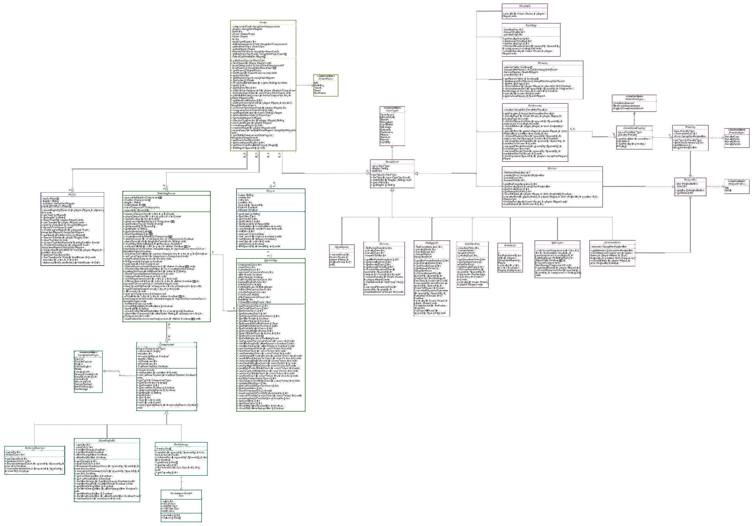
Game
Spaceship
Player
Components
Board
Events

